Slide 1
Parental workshop on Internet Safety for children and teenagers

Slide 2
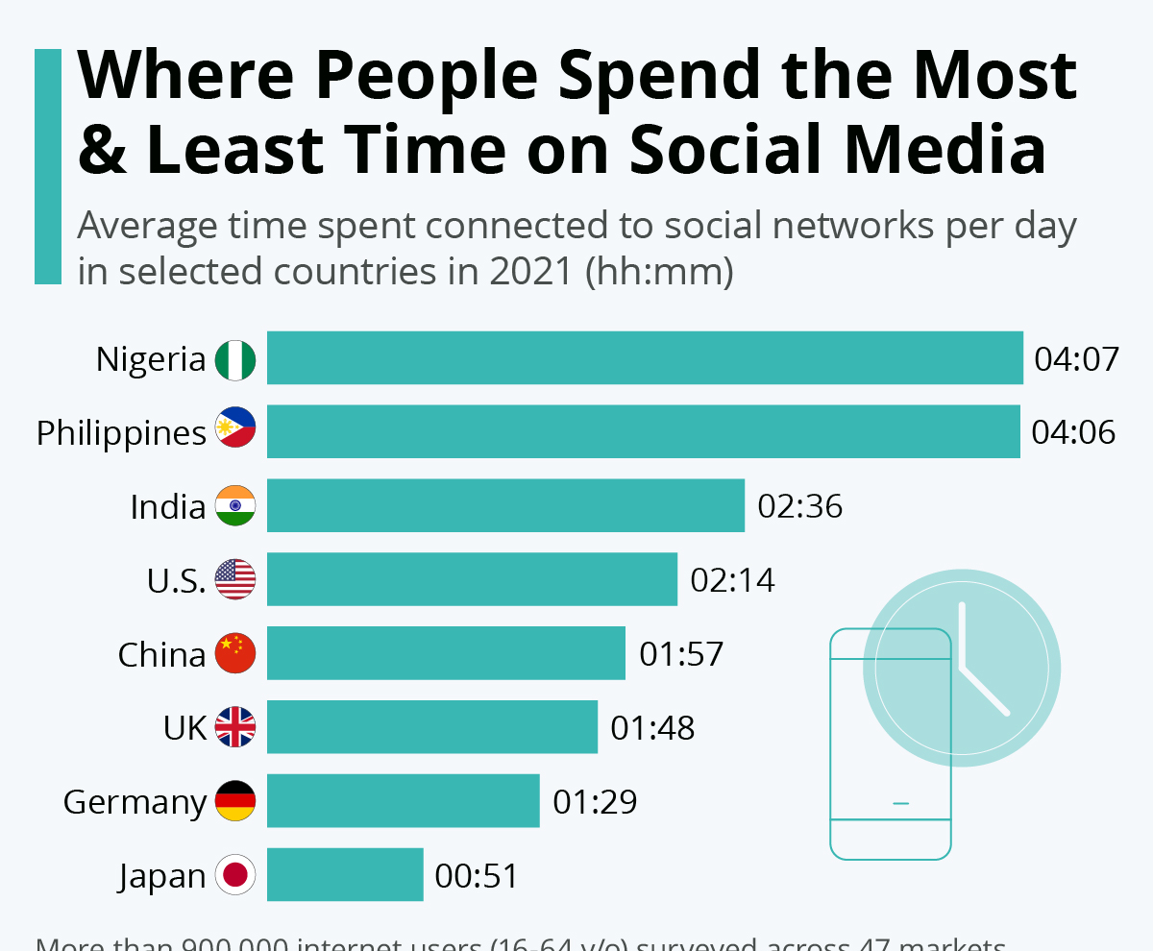
To check your child’s screen time and which platforms they are using, go to:
Andriods
Settings
Digital Well Being and Parental controls
For iphones:
You can even set them a goal to reduce screen time!
Setting
Screen Time

Slide 3
What is social media?
Social media refers to any digital platform, system, website or app that enables people to create and share content, and connect with each other.
We shall look at a few of the most popular sites that teenagers use, how they work and the possible dangers.

Slide 4
How Social Media Is Destroying Our Brains - YouTube

Slide 5
IDENTIFY THE ICON
A
B
C
D
E
F
Notes:
A = NO ATTRIBUTION REQUIRED
B=Free for Commercial use
C= Free under Creative Commons
D=
E=
F=
A list of licenses for the images used in this presentation can be found here: https://creativecommons.org/licenses/

Slide 6
IDENTIFY THE ICON
A
B
C
Pinterest
Facebook
Snap Chat
D
E
F
Google Plus Internet-based social network owned and operated by Google.
LinkedIn
Twitter
Notes:
A = NO ATTRIBUTION REQUIRED
B=Free for Commercial use
C= Free under Creative Commons
D=
E=
F=
A list of licenses for the images used in this presentation can be found here: https://creativecommons.org/licenses/

Slide 7
https://www.esafety.gov.au/key-issues/esafety-guide - check this site for more apps and their safety features

Slide 8
PEGI – Pan European Game Information
PEGI (Pan European Game Information) is a content rating system that ensures all video games are labelled with a minimum age recommendation.
PEGI Categories
“NHS opens clinic to help child addicts of computer games” –
What does this Guardian Newspaper Headline make you feel?
PEGI rates content under eight further categories to warn parents about thing like
Sex
Violence
Bad Language
Drugs
Notes:
PEGI – Image used as reference for educational purposes
Author Attribution: Ask About Games.com

Slide 9
LINK THE GAME TO THE AGE SUITABILITY
A
Fortnite
1
18
B
Call of Duty: Black Ops 4
2
12
C
Minecraft
3
18+
D
FIFA 19
4
7
E
Apex Legends
5
3
F
Grand Theft Auto V
6
16
Notes:
Copyright Attributes:
BACKGROUND IMAGE - GraysonArthur2017
TOP LEFT AND RIGHT - Natalia Medd
A list of licenses for the images used in this presentation can be found here: https://creativecommons.org/licenses/

Slide 10
ROUND
LINK THE GAME TO THE AGE SUITABILITY
A
Fortnite
1
18
B
Call of Duty: Black Ops 4
2
12
C
Minecraft
3
18+
D
FIFA 19
4
7
E
Apex Legends
5
3
F
Grand Theft Auto V
6
16
Notes:
Copyright Attributes:
BACKGROUND IMAGE - GraysonArthur2017
TOP LEFT AND RIGHT - Natalia Medd
A list of licenses for the images used in this presentation can be found here: https://creativecommons.org/licenses/

Slide 11
BBFC – British Board of Film Classification
The BBFC (British Board of Film Classification) has informed UK residents of the age suitability of films, TV and music videos. BBFC ratings are broken down into seven age categories
BBFC Seven Categories
BBFC rates content under three further levels. These headings are
Frequent
Mild
Strong
Notes:
BBFC – Image used as reference for educational purposes
Author Attribution: BBFC

Slide 12
Digital Footprints
https://www.youtube.com/watch?v=shSXIPbVhoE

Slide 13
Internet Safety Laws
True… or false?

Slide 14
Making threats to somebody online is legal
FALSE
Under the 1997 Harassment Act, it is illegal to threaten somebody by person, phone or over the internet.

Slide 15
Sending an unwanted sexual photo or message is illegal.
True! (Partially)
Under the Malicious Communications Act 2003, if you are sending unwanted pictures or messages to people that could be considered sexual or explicit, you may be breaking the law by harassing them.
Remember: everything you do online has a consequence – just like in real life.

Slide 16
Social media websites such as Facebook, Instagram, Snapchat can also get into trouble if somebody misuses them.
COMPLETELY FALSE.
Your consequences are your own. If you have decided to misuse social media to hurt, harass, upset, bully or offend somebody – you deal with the consequences. Social media websites make a lot of money with little consequences.

Slide 17
Making threats to somebody online is legal
FALSE
Under the 1997 Harassment Act, it is illegal to threaten somebody by person, phone or over the internet.

Slide 18
There is no age limit on Facebook. You can sign up no matter how old you are.
FALSE. It is 13.

Slide 19
The dangers Internet!
Cyberbullying
Threats, gossip, insults, intimidation, abuse, etc
Inappropriate Content
Pornography, violence, adult websites, etc
Privacy Violation
Invasion of your own space, sharing your personal info, photos, etc
Data theft
Someone stealing your personal information (names, addresses, bank details) normally through fake e-mails and websites
Online predators
People who try to establish a close relationship with young people so they can blackmail, abuse or even kidnap their targets in the real world.

Slide 20
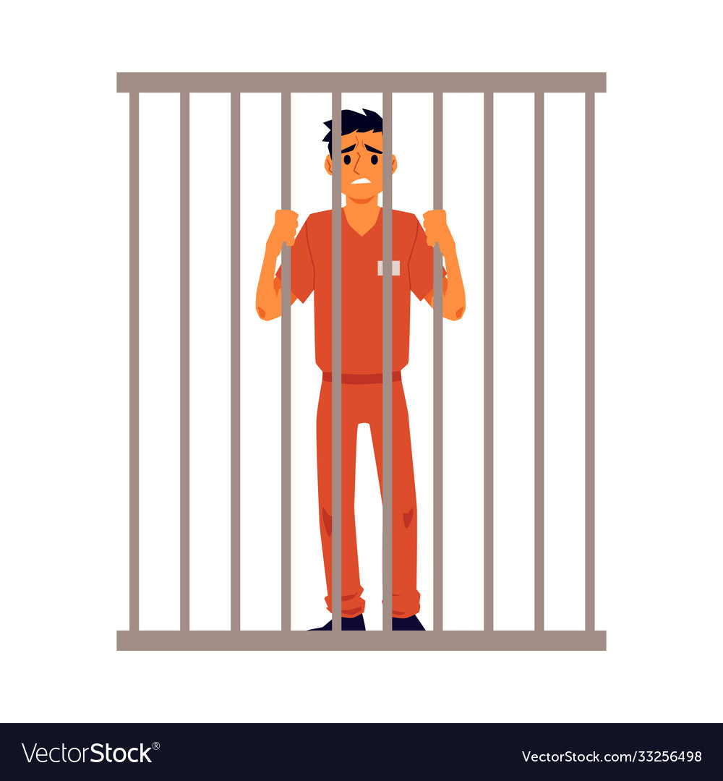
Match the criminal offence to its explanation and guess the penalty.
Harassment
Malicious communication
Grossly offensive communication
Obscene communication
Hacking

Slide 21
Harassment
The Protection from Harassment Act 1997, it is a criminal offence for a person to pursue a course of conduct which amounts to the harassment of another, which the perpetrator knows or ought to know amounts to harassment. This could include sending a person multiple abusive emails with the intention of causing alarm or distress.
Six months imprisonment, a financial penalty or both.

Slide 22
Malicious communication
The Malicious Communications Act 1988 states that it is an offence for any person to send a communication that is "indecent or grossly offensive" for the purpose of causing "distress or anxiety to the recipient". This also includes threats and false information.
Six month imprisonment, a fine (currently of up to £5,000) or even both.

Slide 23
Grossly offensive communication
The Communications Act 2003 makes it a criminal offence to send via any electronic communication network a message or other matter that is deemed "grossly offences or of an indecent, obscene or menacing character".
Six months in prison, a fine, or both.

Slide 24
Obscene communication
The Obscene Publications Act 1959 makes it an offence to publish an obscene article. An obscene article is classed as one whose effect is to deprave and corrupt persons likely to read, see or hear the matter contained or embodied in the article.
Up to 3 years imprisonment.

Slide 25
Obscene communication
The Obscene Publications Act 1959 makes it an offence to publish an obscene article. An obscene article is classed as one whose effect is to deprave and corrupt persons likely to read, see or hear the matter contained or embodied in the article.
Up to 3 years imprisonment.

Slide 26
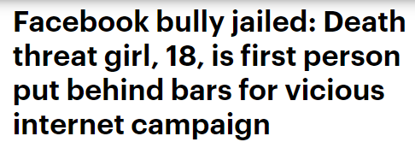
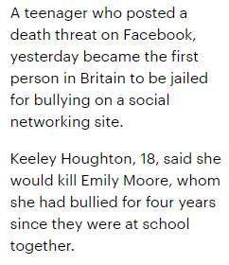
Harassment – an example
Yesterday, jobless Houghton sobbed as she was sentenced to three months in a young offenders' institution after pleading guilty to harassment.
She was also given a restraining order banning her from contacting Emily in person, via the internet or in any other manner for five years.
People have previously been jailed for harassment and stalking on social networking sites but she is thought to be the first to be jailed for bullying via the internet.
What are your thoughts on this case?
How would you counter argue the point she is only a teenagers and didn’t understand what she was doing?

Slide 27
Staying up to date with new trends
It can be really hard to keep up to speed with all the different social media platforms young people are using online. Here are some simple ways to stay on top of the trends:
Check the e-safety website it lists all social platforms, what they do, and how they are used (https://www.esafety.gov.au/key-issues/esafety-guide)
Ask Google. Seriously. It might sound simple, but searching for 'popular social media platforms UK' will give you a detailed list of popular and new platforms, and what they do.
Talk to your kids! Just ask them which apps or programs they use, and why. Questions to ask:
Who uses the app? Who do you talk to on there?
Ask them to make sure they are protecting their identity and being safe.
What kind of information or articles do they share?
Ask them to be the expert and show you how it's used.
Talk to school teachers, particularly the head of IT, about what the students are using, or ask them to have an expert come and chat to the school community. Some local area youth liaison police officers are also available to come and talk to your school or community about current e-safety trends.

Slide 28
Some websites that can support or provide information
https://www.esafety.gov.au/young-people
2. Think you know www.thinkyouknow.co.uk
3. CEOP
4. https://www.internetmatters.org/hub/news-blogs/yubo-formerly-yellow-social-media-app-parents-need-know/
5. Fixers www.fixers.org.uk

Slide 29
You can call ChildLine and speak to one of their online counsellors. The call is FREE and whatever is said is confidential and stays between you!
If your nervous about calling then you can use the ChildLine message board and speak to different people for support and advice.
www.childline.org.uk
Ask Sam is a problem page where you can read letters from other children and ask for advice yourself
If you want a 1-1 with a counsellor but online rather over the phone then click on online chat and speak to someone via instant messanger

Slide 30
ChildLine website

Slide 31
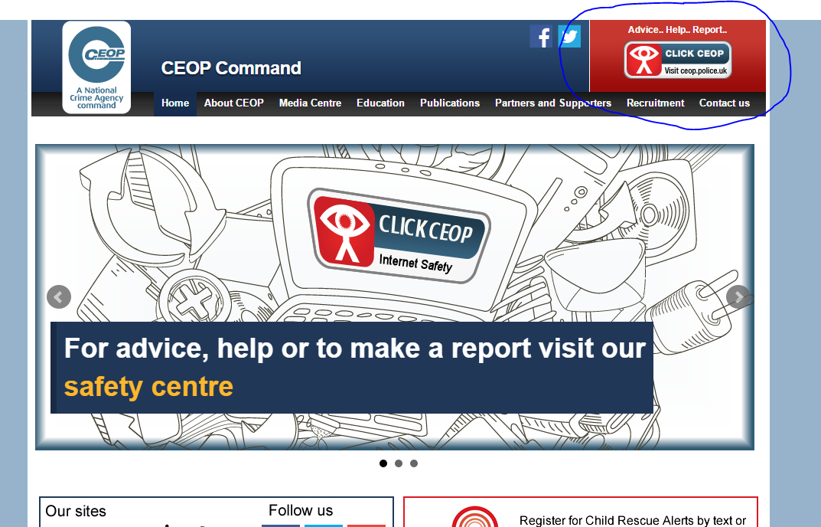
CEOP (Child Exploitation and Protection website

Slide 32
The End

